Slide 1



How to Quickly Build a Repeatable SQL Server Lab
Amy Cox
She/Her
Independent Consultant / DBA
Ms SQL Server DBA
Notes:
In this session we’ll learn how to create an ephemeral SQL Server Home Lab on HyperV using Packer, Terraform, and PowerShell. This lab includes a domain controller, a Windows Cluster, and SQL Server availability groups. We’ll also build highly available Azure and AWS resources. After the session you can find this presentation and the code in my GitHub repo at github.com/CloudSQLDBA/HomeLab.

Slide 2
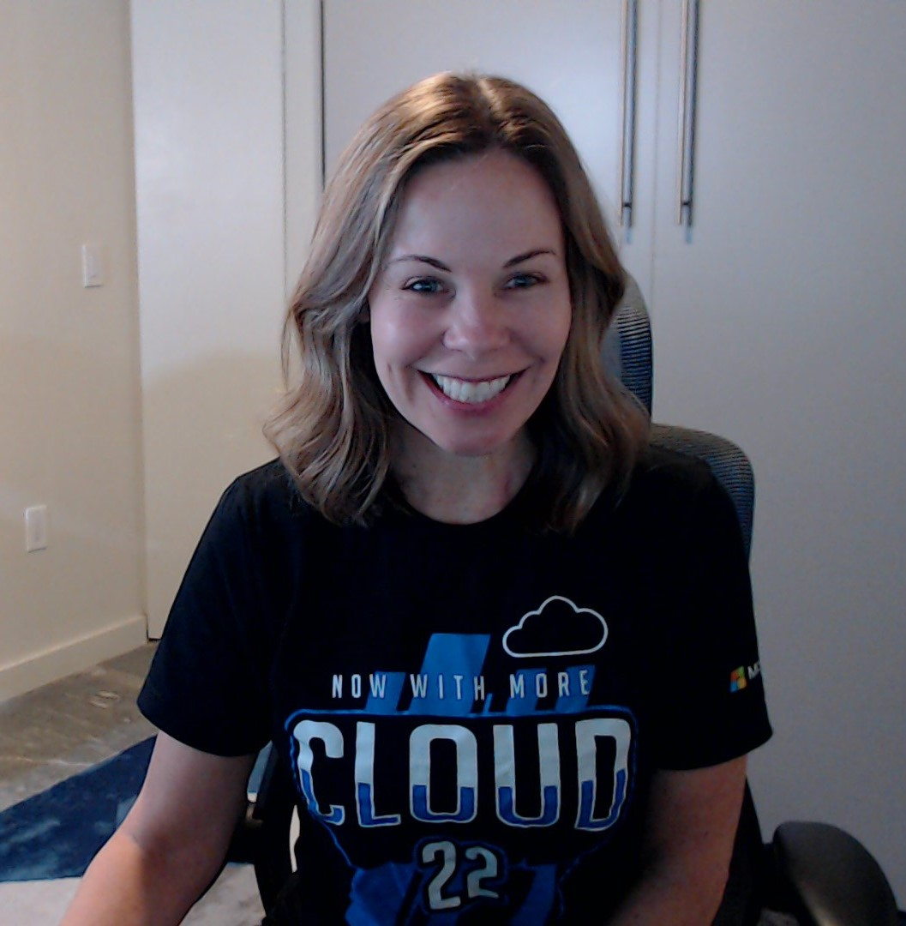



Amy
I’ve been working with SQL Server for over two decades. I’ve been a developer, a DBA, and a manager. I’ve worked for private companies, large public companies, and non-profits. I’ve worked for federal, state, and local government. I’m an Air Force veteran. Currently I’m working on a contract for a small fintech startup.
Cox
She/Her
Independent Consultant DBA
Ms SQL Server DBA
MsSQLServerDBA@hotmail.com
www.linkedin.com/in/amycox
github.com/CloudSQLDBA/HomeLab

Slide 3

What is a home lab and why do you need one?
Notes:
A home lab can be physical or virtual but it’s just a place where you can go to learn, test, and play around. It’s a place you can go to answer your own questions and also to answer other people’s questions. Mine is on my laptop.

Slide 4
How can I create a home lab? that is …
Free
Easy
Fast
Notes:
This is the main question we’ll be answering today.

Slide 5
Infrastructure as Code (IaC) … the managing and provisioning of infrastructure through code instead of through manual processes
Notes:
Infrastructure as Code (IaC) is the managing and provisioning of infrastructure through code instead of through manual processes.

Slide 6
Terraform … an infrastructure as code tool that enables you to safely and predictably provision and manage infrastructure
Notes:
Terraform is one popular way to implement Infrastructure as code. In fact, there’s a chance that the infrastructure team where you work is using Terraform.

Slide 7
Packer … a tool for building identical machine images for multiple platforms from a single source configuration
Notes:
When I built my first HyperV lab, I used all the GUIs! One of the parts I hated the most was installing Window Server on each VM, using the wizard. I don’t think you can install Windows Server with PowerShell. You just boot from an ISO and you’re forced to go through the install steps. Packer lets you build an image with the OS and other software, like SQL Server, already installed. You can use that image over and over.

Slide 8
Pre-requisites & Components
PowerShell
HyperV
Chocolatey
Azure CLI
Visual Studio Code
Terraform
Packer
AWS account
Azure Subscription
GitHub
Notes:
These are some things you’ll probably need installed on your computer to build your lab with the code in my GitHub.

Slide 9
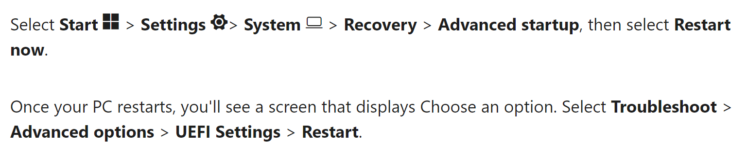
Enable Virtualization in the BIOS on Windows 11
https://support.microsoft.com/en-us/windows/enable-virtualization-on-windows-11-pcs-c5578302-6e43-4b4b-a449-8ced115f58e1
Notes:
I found that on my new laptop I needed to enable virtualization in the BIOS. Microsoft provides these instructions.

Slide 10
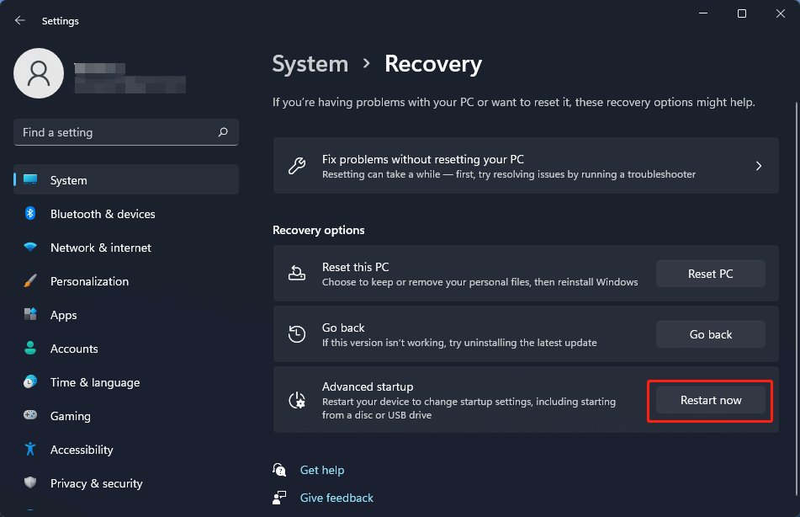
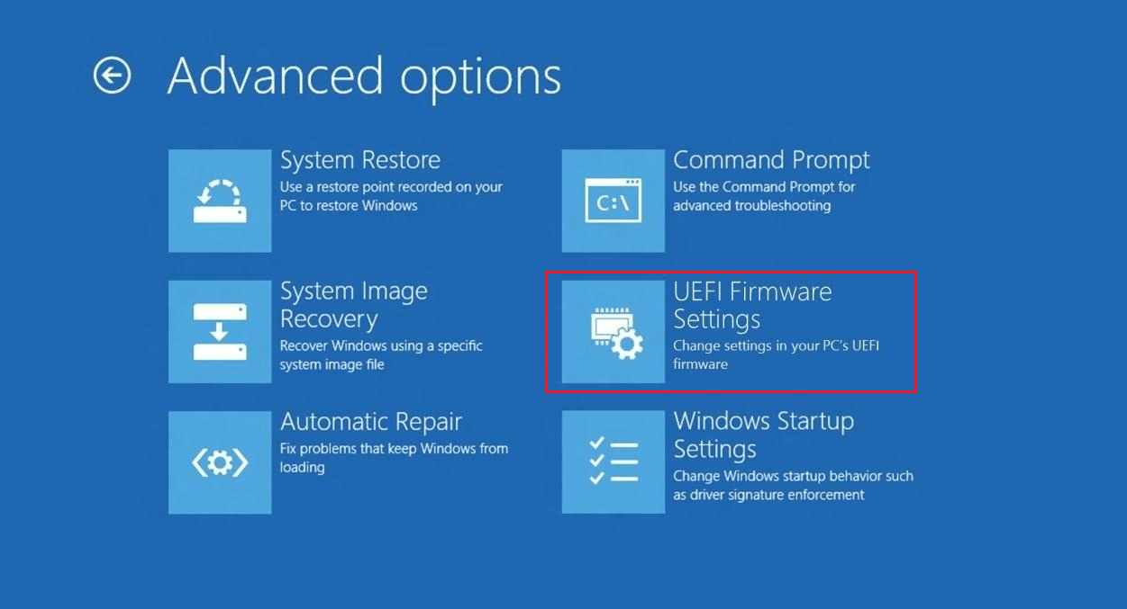
Enable Virtualization in the BIOS on Windows 11
Notes:
This is what you’ll see when following the instructions in the previous slide.

Slide 11
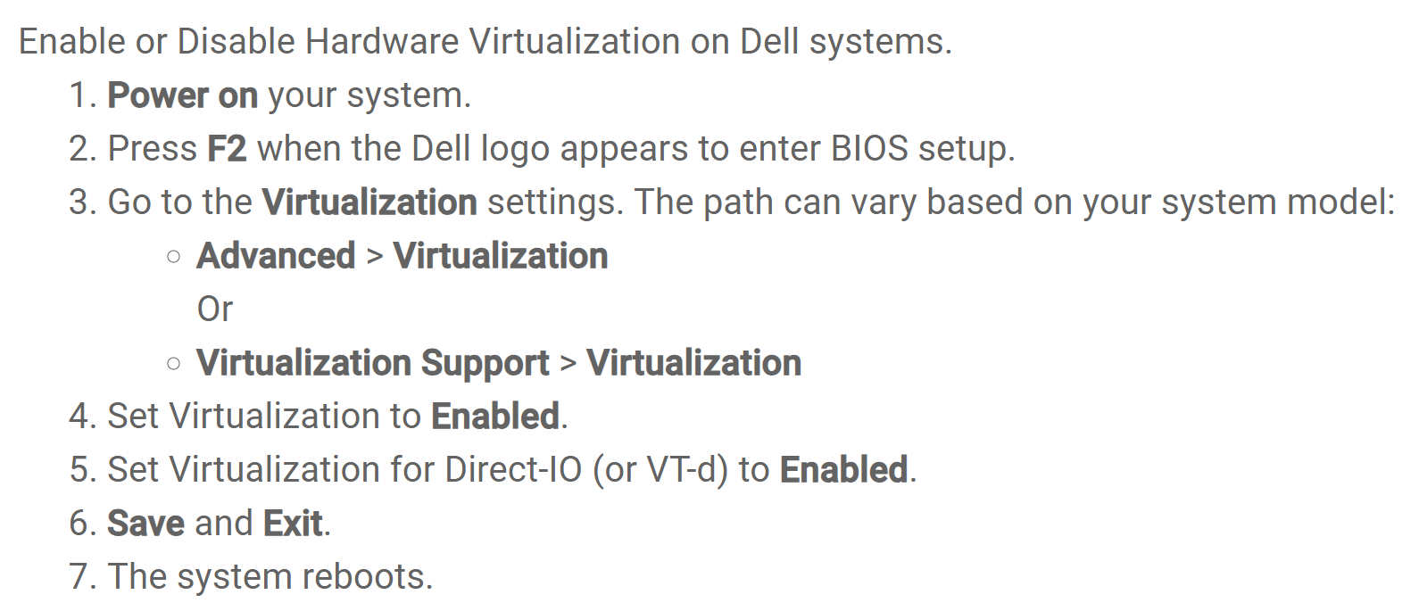
Enable Virtualization in the BIOS on Windows 11
https://www.dell.com/support/kbdoc/en-us/000195978/how-to-enable-or-disable-hardware-virtualization-on-dell-systems
Notes:
My laptop is a Dell and these are the instructions that Dell provides.

Slide 12
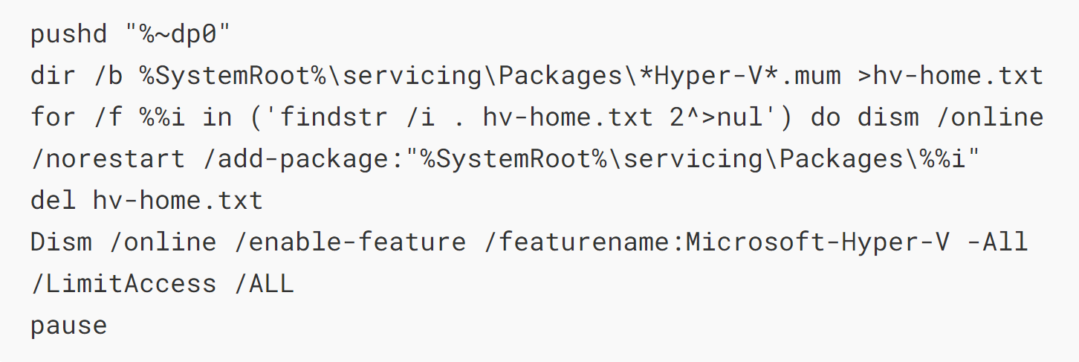
Enable HyperV on Windows 11 Home Edition
Notes:
This is how you can enable HyperV on Windows 11 Home Edition. Put this code in a .bat file.

Slide 13
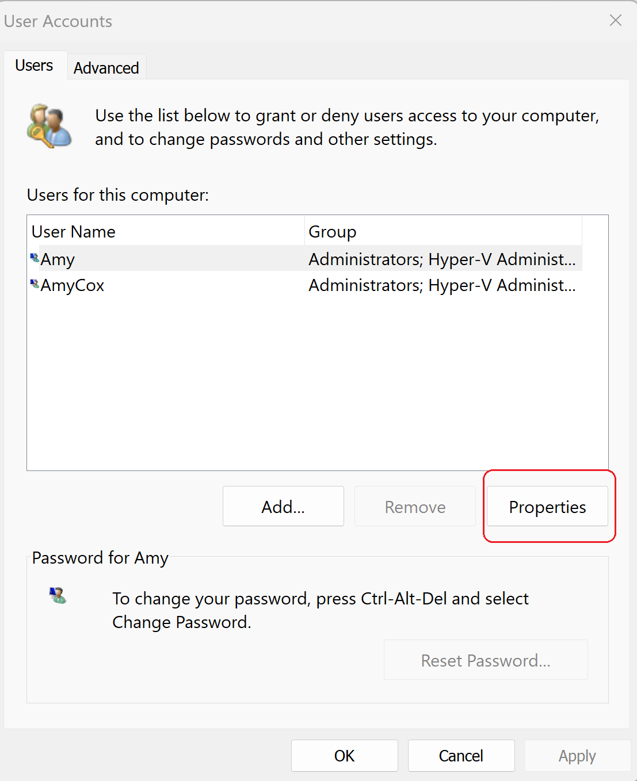
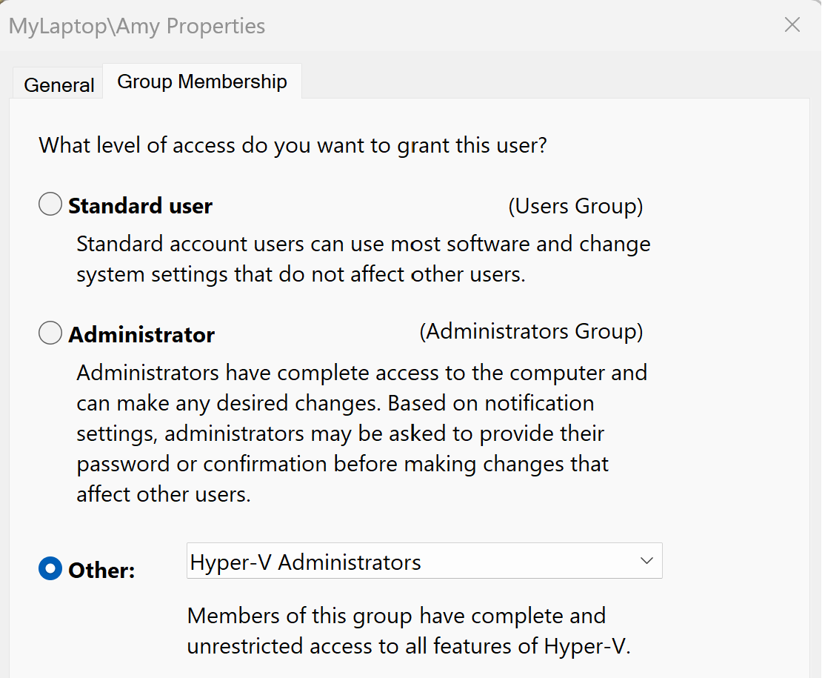
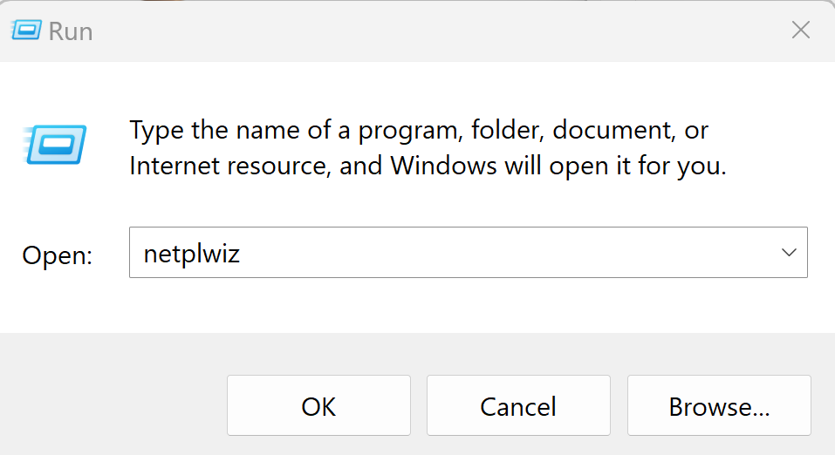
Add user as a HyperV admin on Windows 11 Home Edition
Notes:
You must also add yourself to the HyperV Administrators group. This is how I did it in Windows 11 Home Edition.

Slide 14

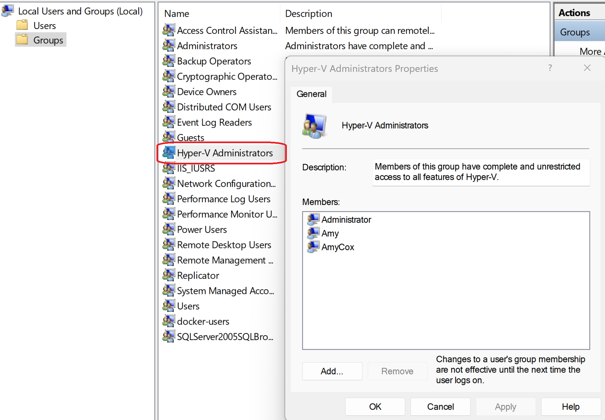
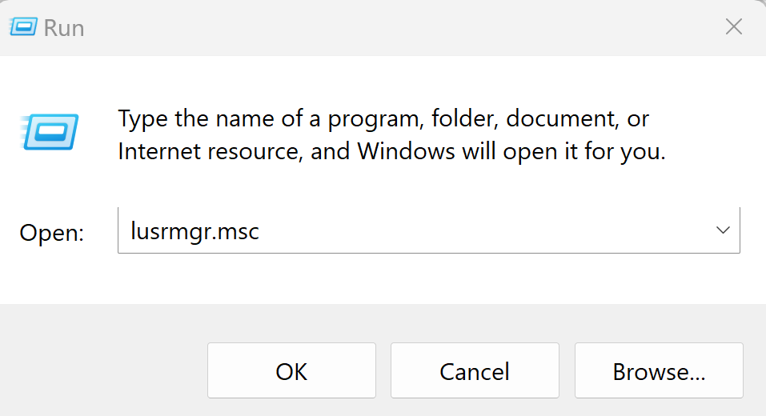
Enable HyperV & add user as a HyperV admin on Win 11 Pro Edition
Notes:
If you have Windows 11 Professional Edition, you can do this using Active Directory Users and Groups.

Slide 15
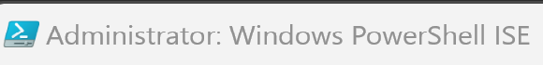
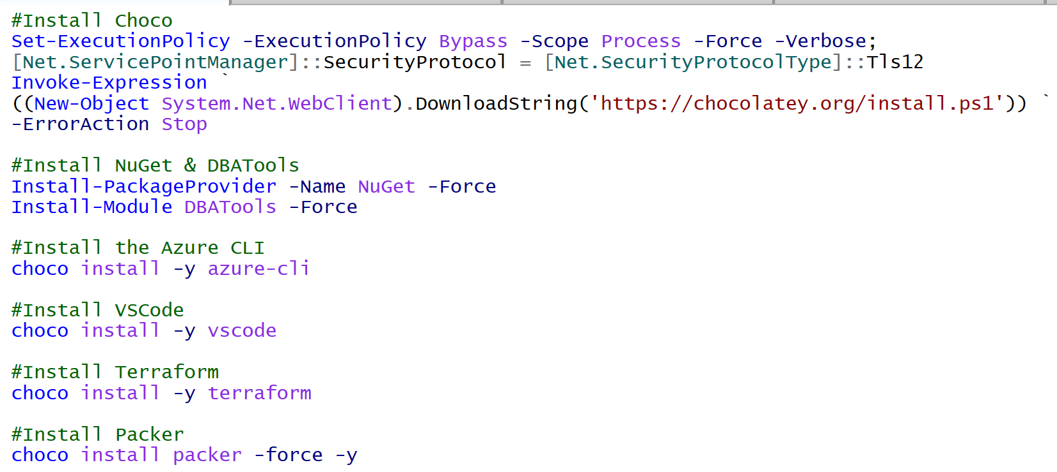
Installs
Notes:
Use the PowerShell ISE, as an Administrator, to install Chocolatey. Use Chocolatey to install NuGet, DBATools, the Azure CLI, VSCode, Terraform, and Packer.

Slide 16
Common files seen in Terraform Projects
providers.tf – contains the resource providers
main.tf – contains the resource blocks that define the resources to be created on the target platform
variables.tf – contains the variable declarations to be used
outputs.tf – contains the outputs generated on successful completion of the “apply” operation
Notes:
Most Terraform projects will typically include these four files – but everything can be in one large file, too. Terraform will combine them. You can rename the extension and then run terraform apply to destroy all of the resources in a file.

Slide 17
Common commands used in Terraform
Terraform init
Terraform plan
Terraform apply
Terraform destroy
Notes:
These are the four basic Terraform commands.

Slide 18
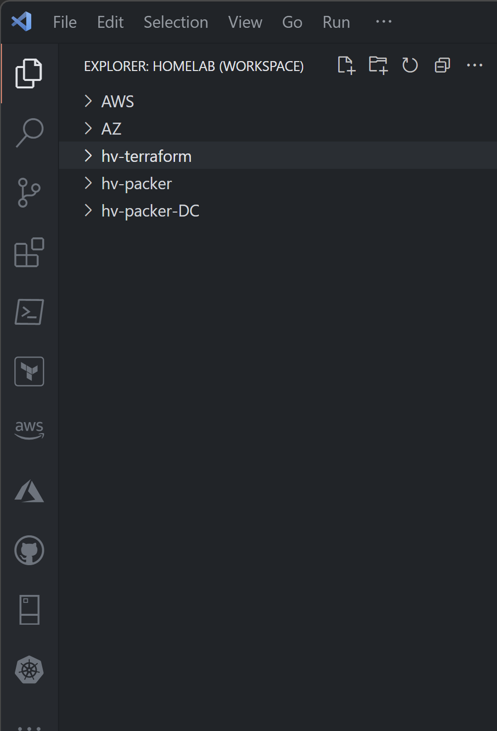


Visual Studio Code Extensions
AWS
AZURE
GITHUB
Powershell
Terraform
Notes:
Visual Studio Code – now that we have VSCode installed, we need to make sure we have a few extensions installed. I have 42 but we probably only need the AWS, Azure, and GitHub extensions for this project. The Powershell and Terraform extensions are always nice to have.

Slide 19
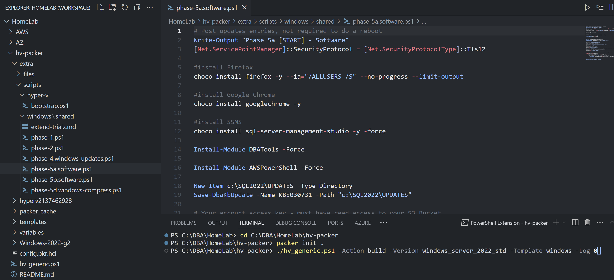
Packer
Notes:
Packer – this will build our Packer image – we need to run packer init – this is very similar to Terraform – then we run the PowerShell script to build our image – I used two different images – one that included SQL Server and one that did not.

Slide 20
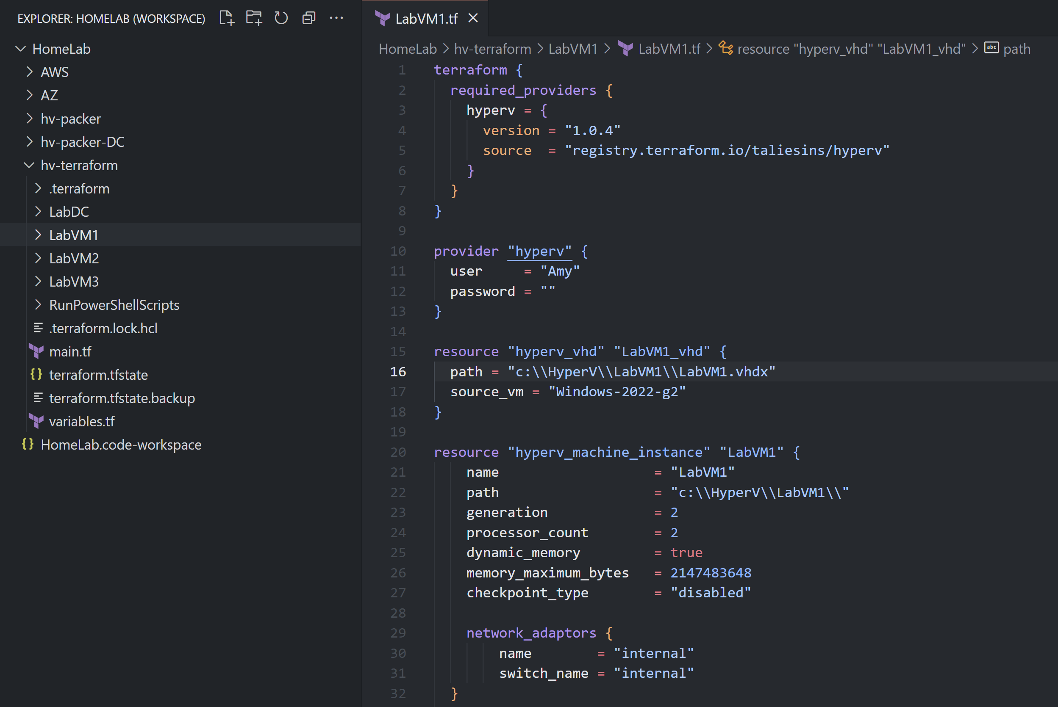
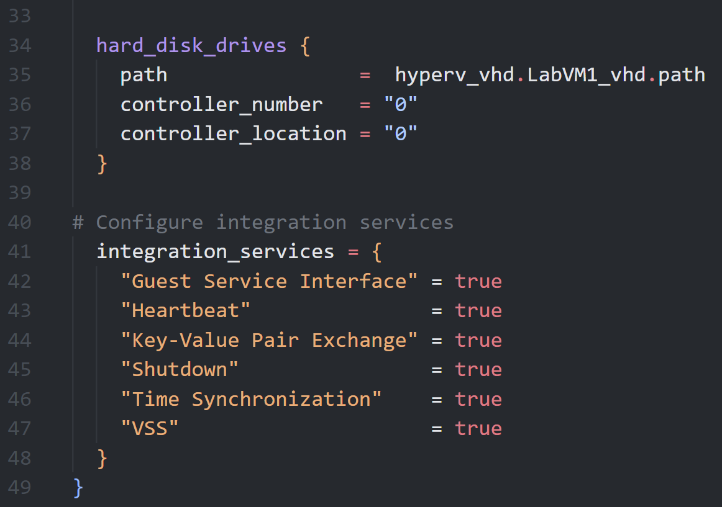
HyperV
Notes:
Terraform – now that we have our image built with Packer, this template will create a VM based on that image. This is exactly what you would normally see in a file named main.tf. This is ALL of the code. This is it. Easy, right?

Slide 21
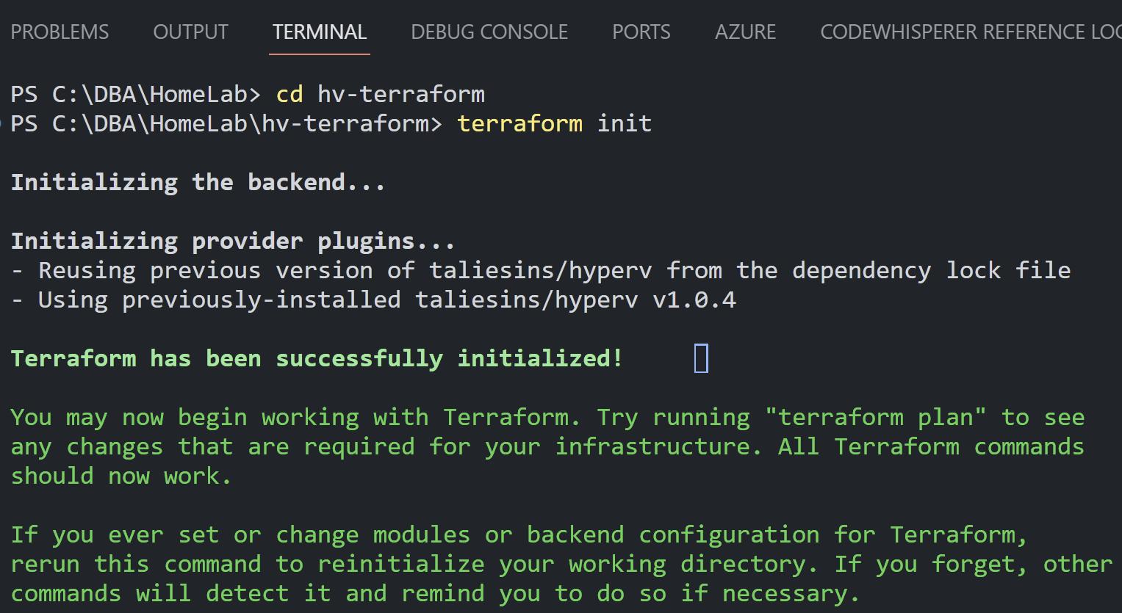
HyperV
Notes:
Terraform init – before we run terraform init – we want to make sure we’re in the same directory as our .tf files…

Slide 22
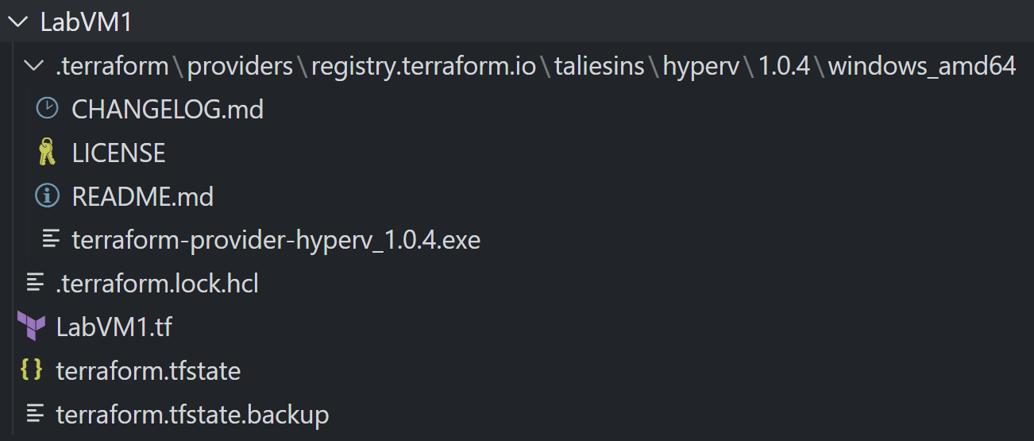
HyperV
Notes:
After running terraform init – we’ll see the terraform providers directory for the first time.

Slide 23
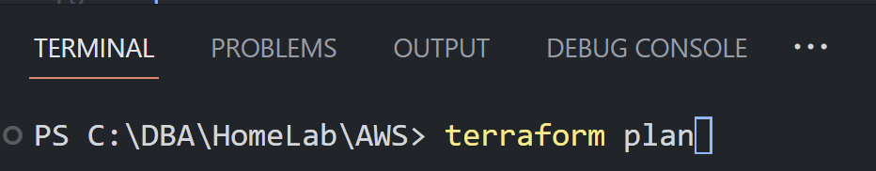
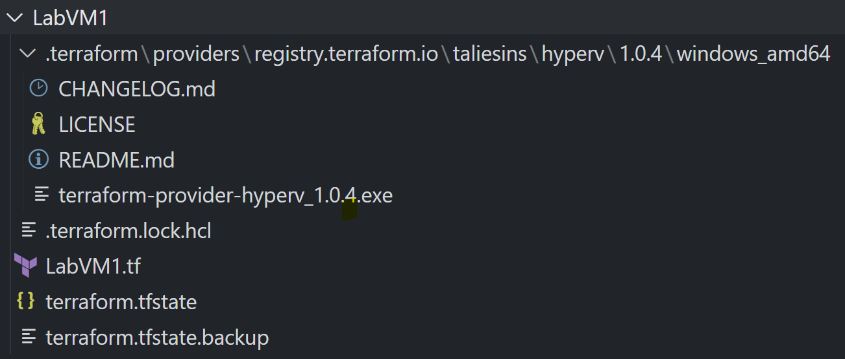
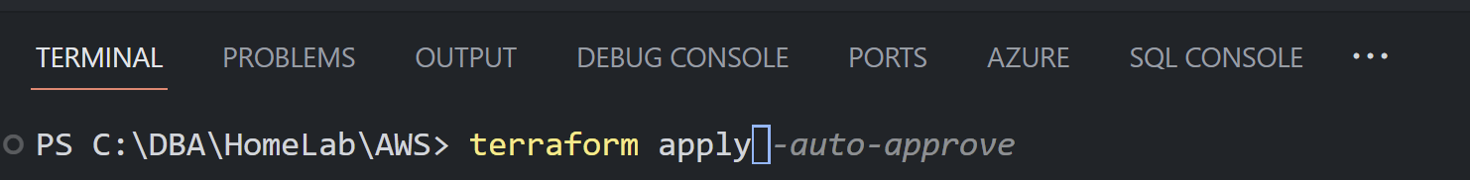
HyperV
Notes:
After running terraform plan and terraform apply – we’ll see these extra terraform files.

Slide 24
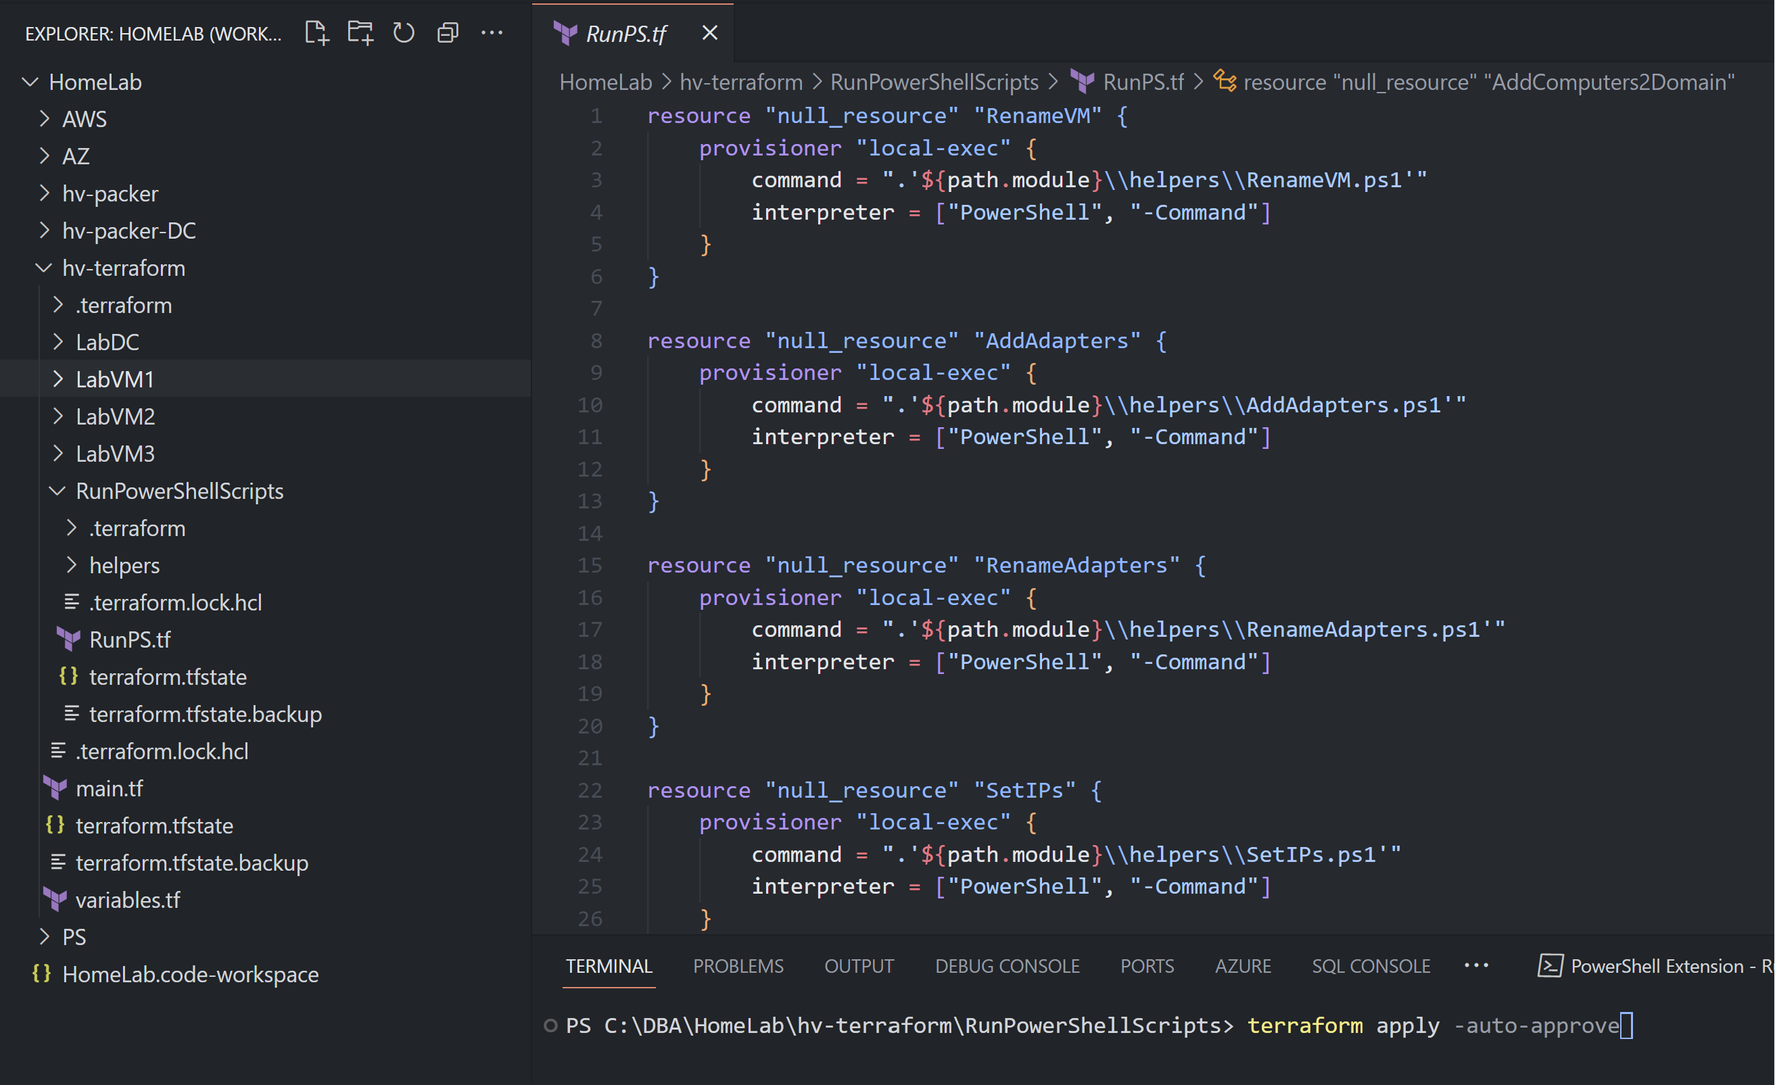
HyperV
Notes:
Terraform – with the null resource provisioner we can execute local PowerShell scripts on the HyperV VMs to build a domain controller, install failover clustering, install and configure SQL, create availability groups, etc.

Slide 25
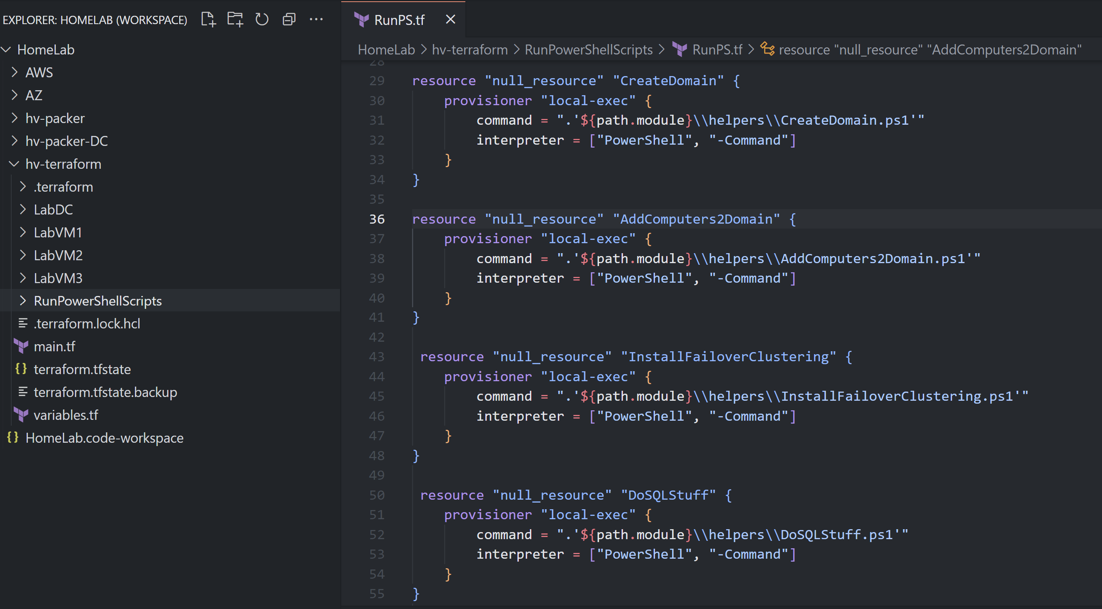
HyperV
Notes:
…

Slide 26
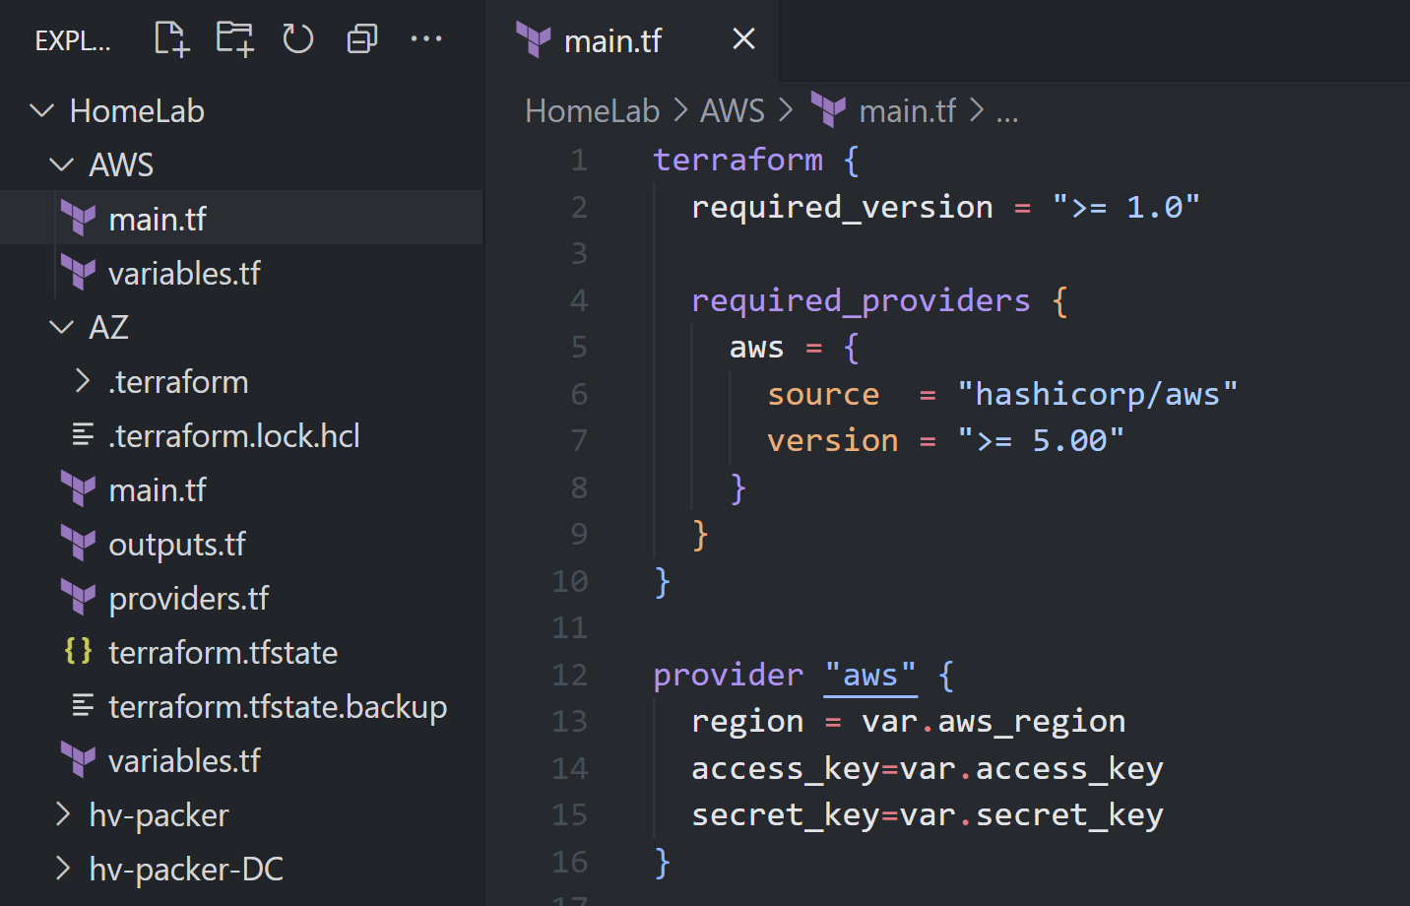
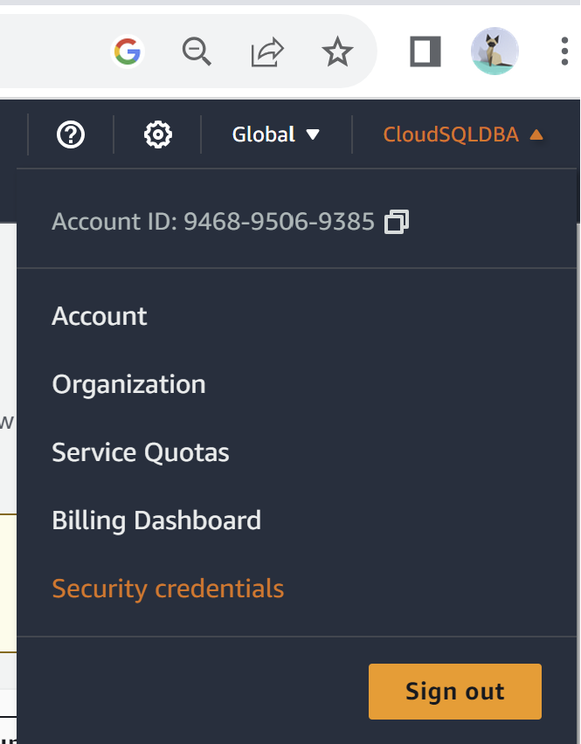
AWS
Notes:
AWS - building a multi AZ RDS instance isn’t so different because it’s still Terraform. Notice that my region, access key, and secret key for AWS are all stored as a variables.

Slide 27
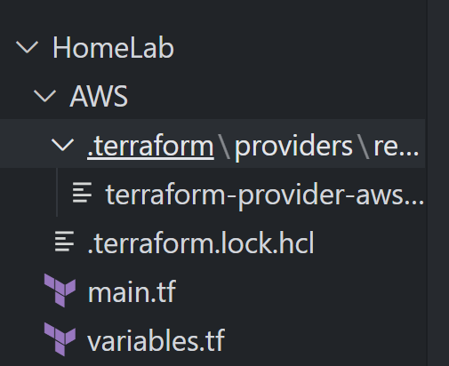
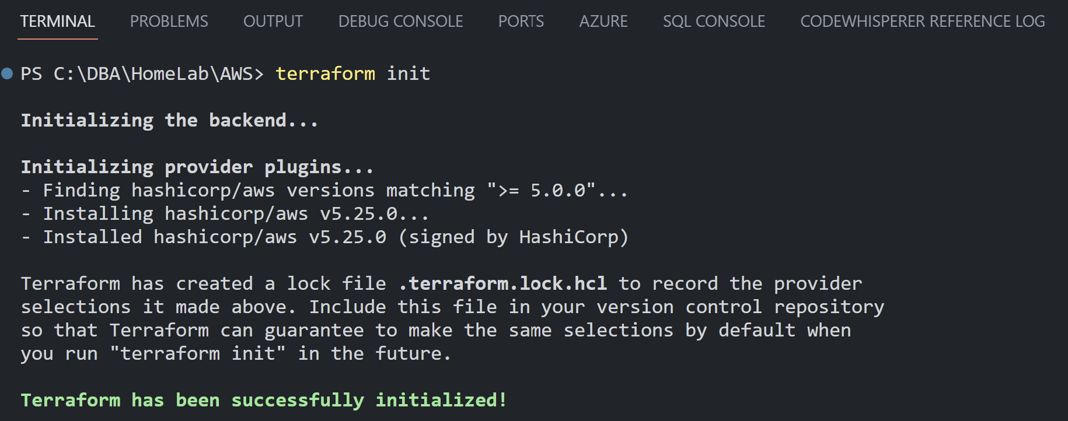
AWS
Notes:
Once again we run terraform init.

Slide 28
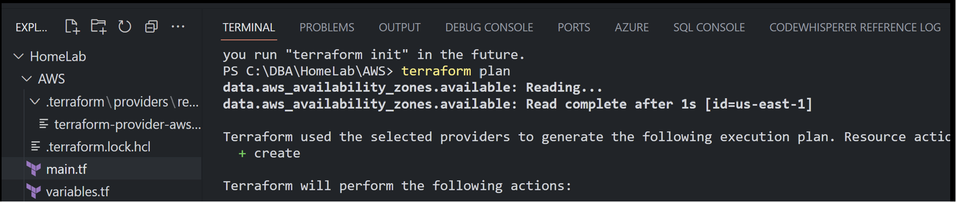
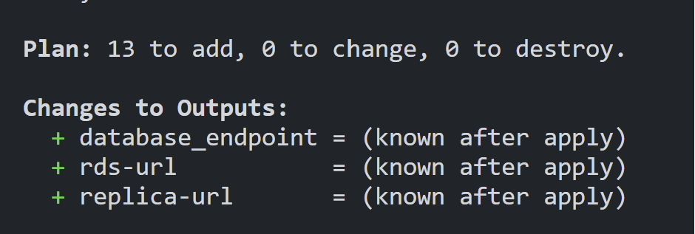
AWS
Notes:
We can also run terraform plan to see that 13 resources will be added. Run Terraform apply to build the resources.

Slide 29
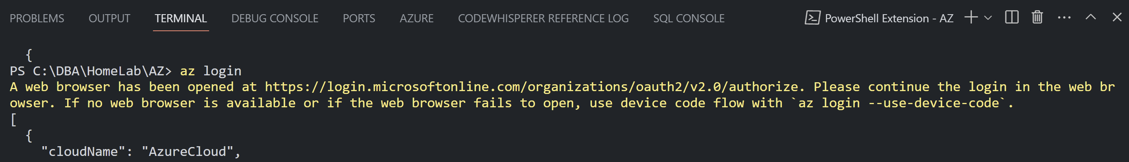
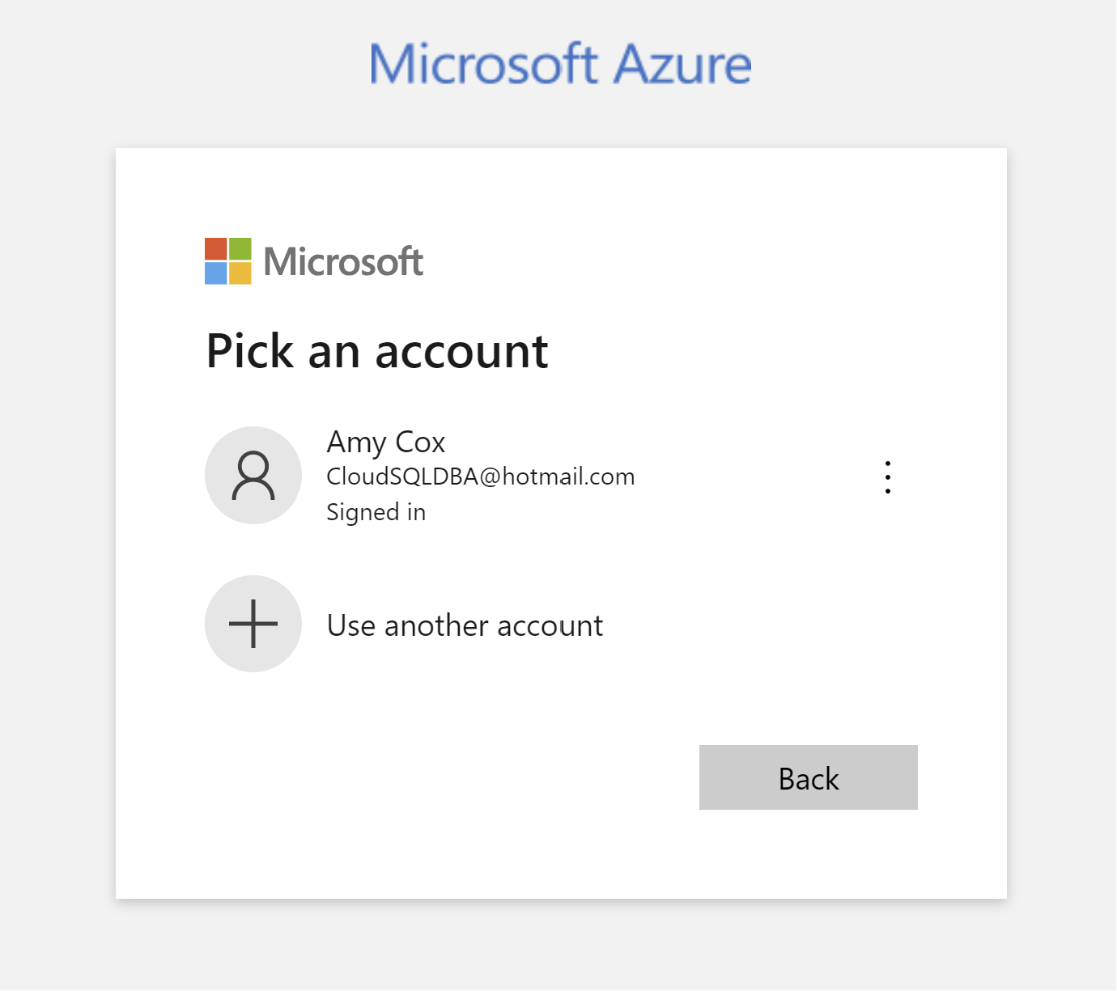
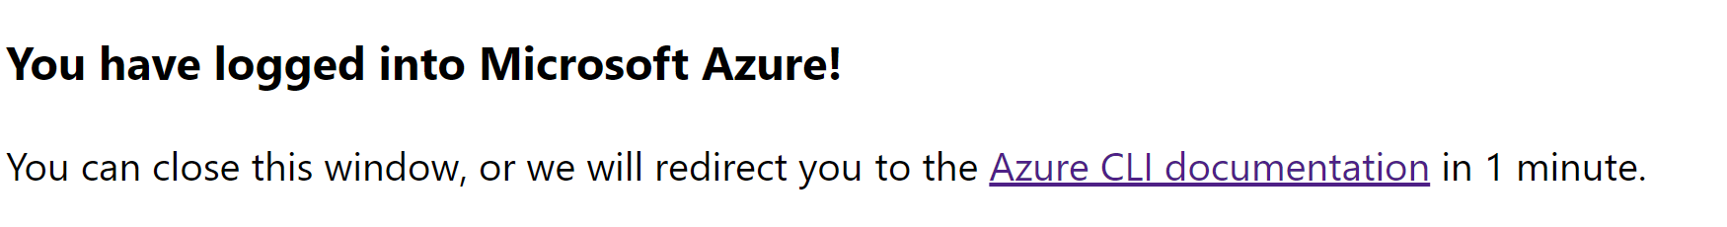
Azure
Notes:
Using Terrafrom to provision resources in Azure is very similar, too. If we type az login in the terminal window, we’ll be prompted to authenticate via a browser.

Slide 30
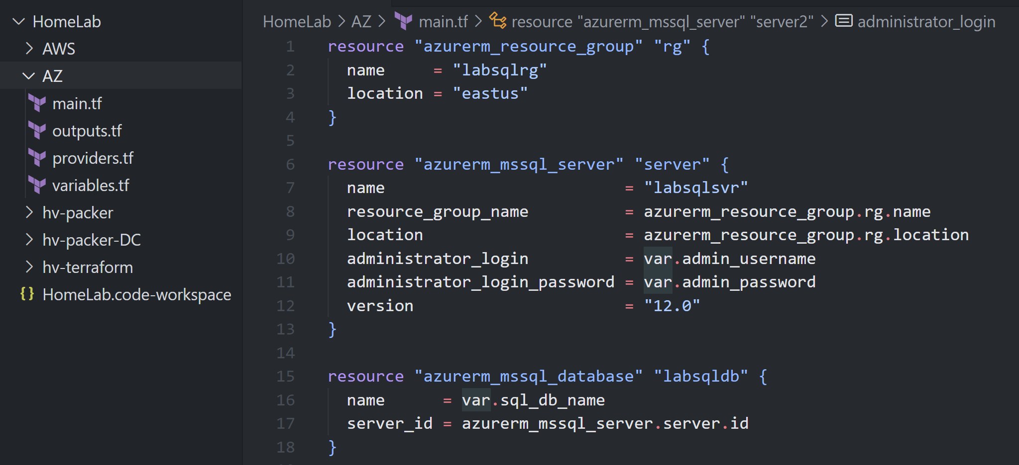
Azure
Notes:
This is what are code looks like for Azure…

Slide 31
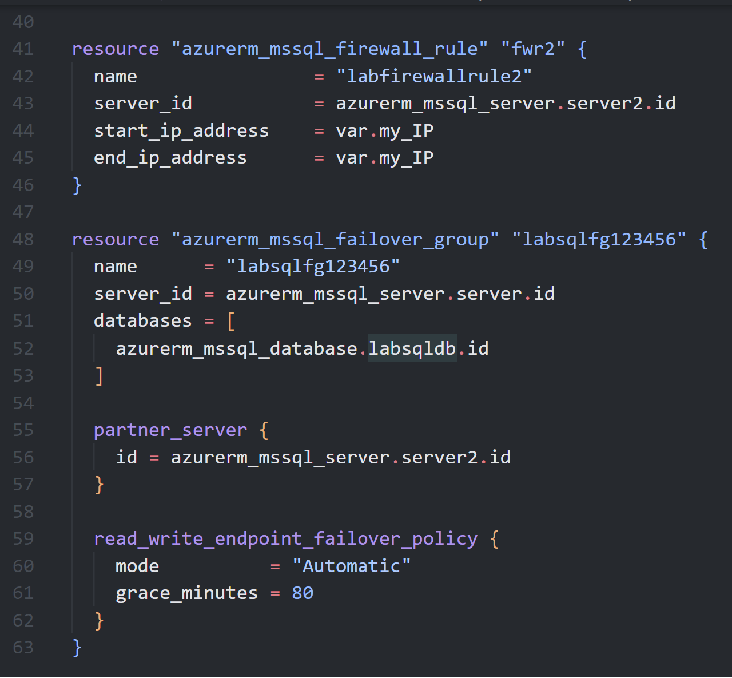
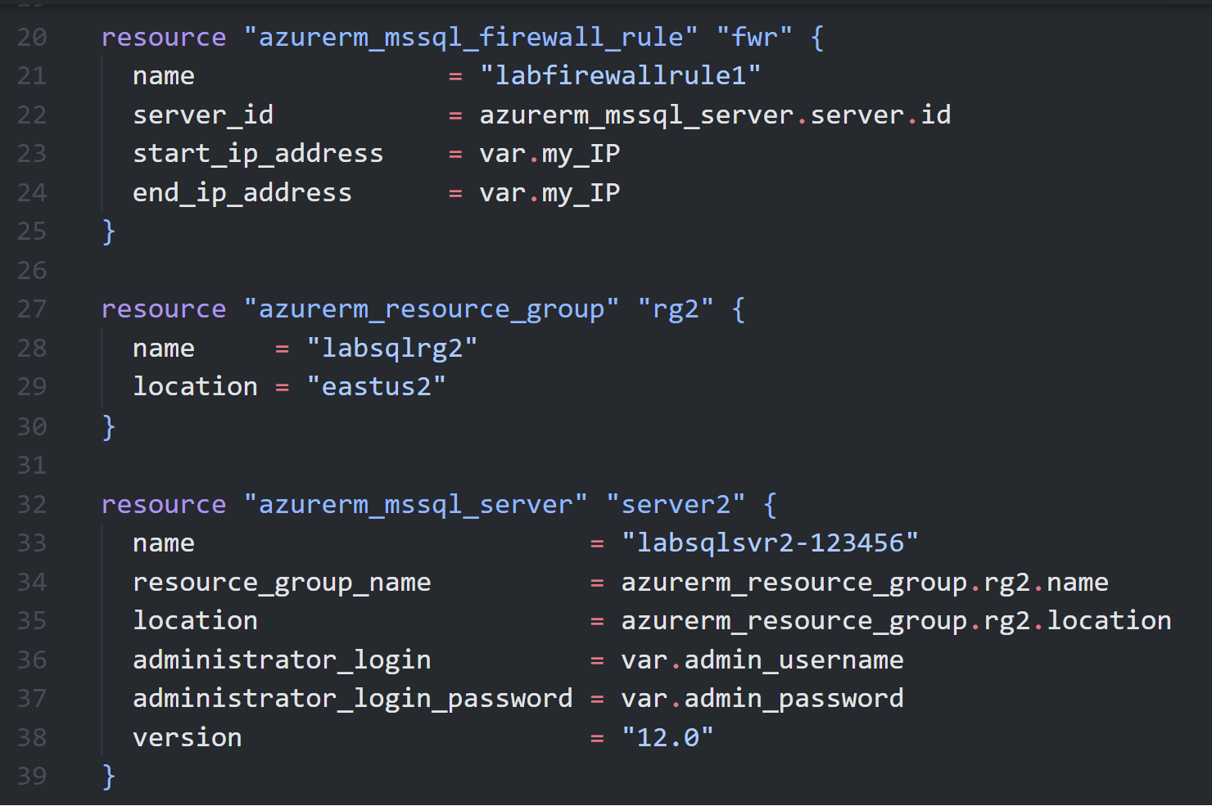
Azure
Notes:
…

Slide 32
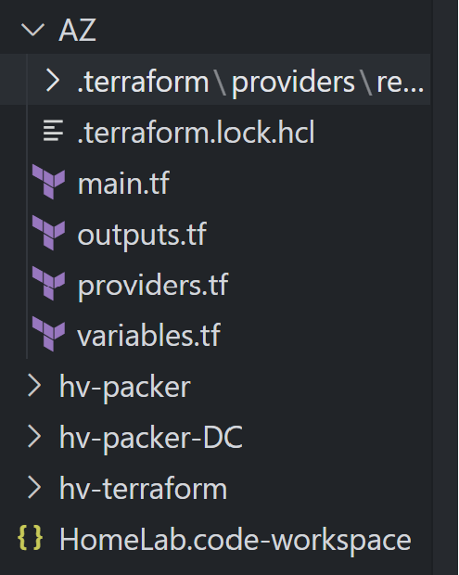
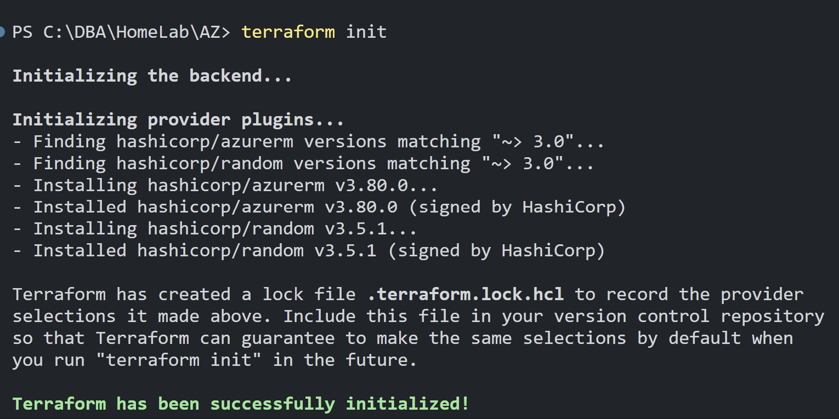
Azure
Notes:
Run terraform init.

Slide 33
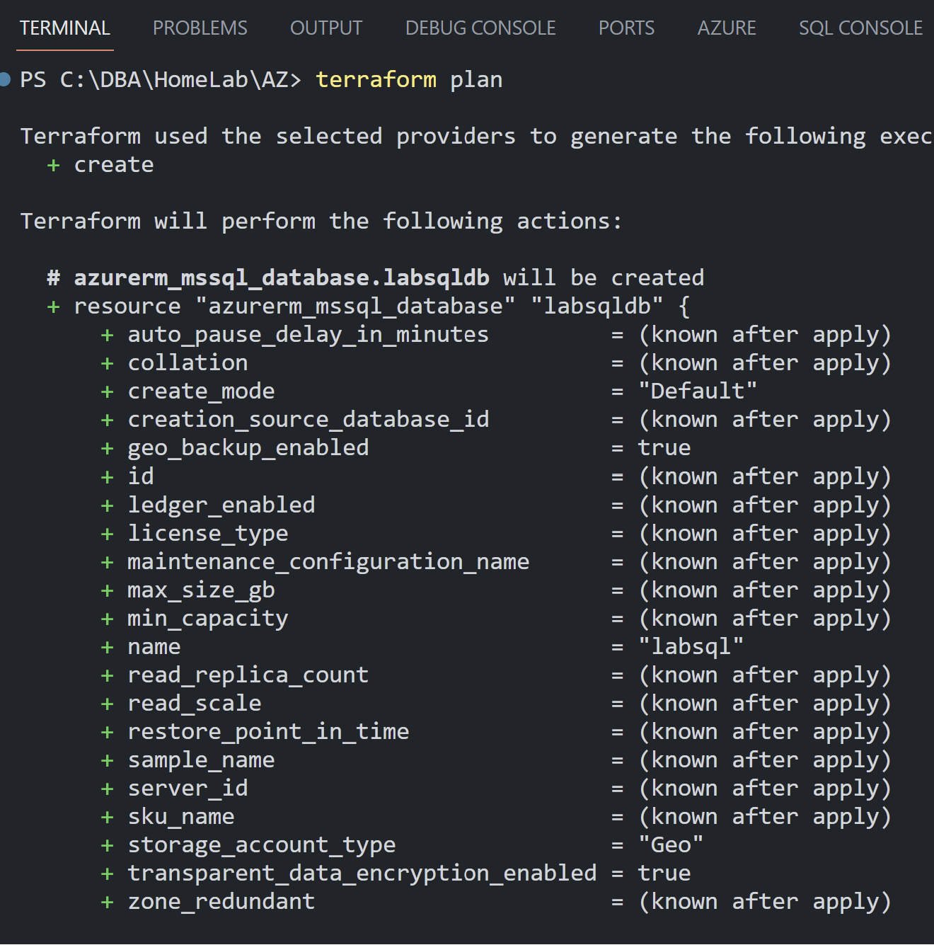
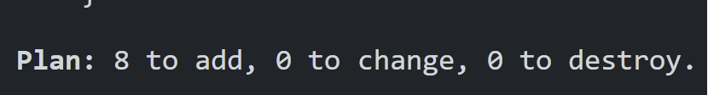
Azure
Notes:
We can see that 8 resources will be added.

Slide 34
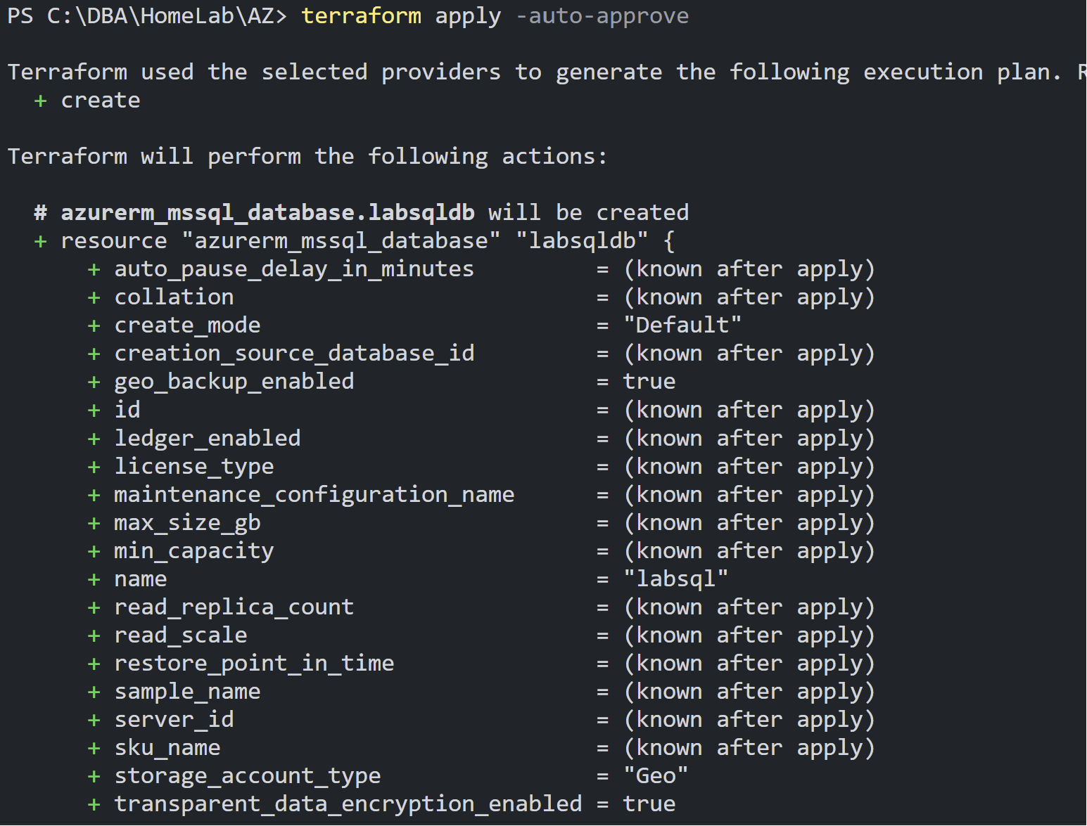
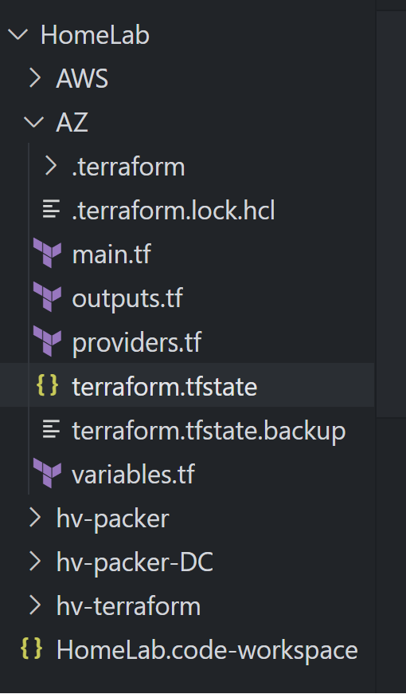
Azure
Notes:
Run terraform apply. If we include –auto-approve, we will not be prompted to respond with yes/no.

Slide 35
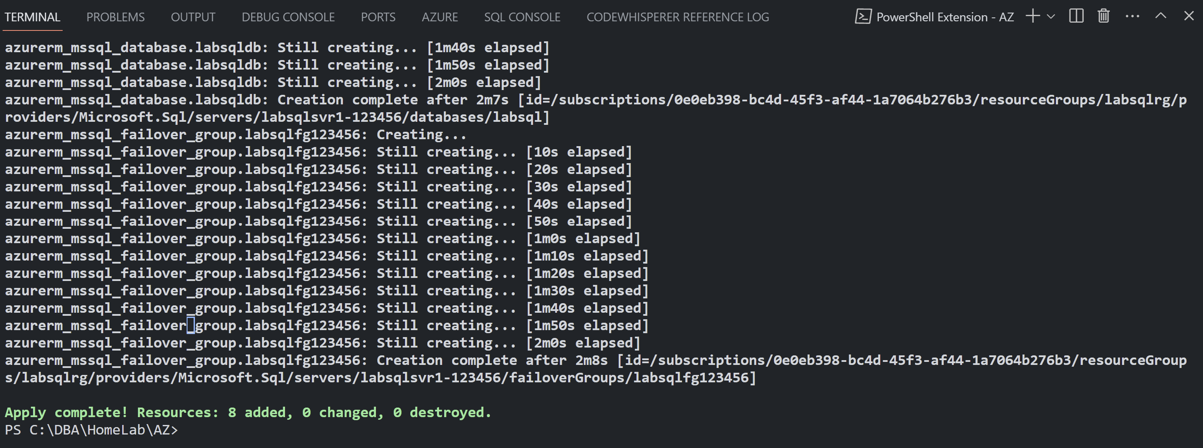
Azure
Notes:
We can see that we provisioned 8 resources, just like our plan told us.

Slide 36
Resources
https://github.com/CloudSQLDBA/HomeLab
https://www.ryanjadams.com/2019/10/build-a-sql-cluster-lab-part-1/
https://registry.terraform.io/browse/providers
https://developer.hashicorp.com/terraform/tutorials/provision/packer
Notes:
I’ve included just a few resources here that I hope will help you in your journey to provision your own home lab, either ‘on-prem’, in the cloud, or both. Happy learning!

Slide 38
How to Quickly Build a Repeatable SQL Server Lab
Amy Cox
MsSQLServerDBA@hotmail.com
www.linkedin.com/in/amycox
github.com/CloudSQLDBA/HomeLab

